Slide 1
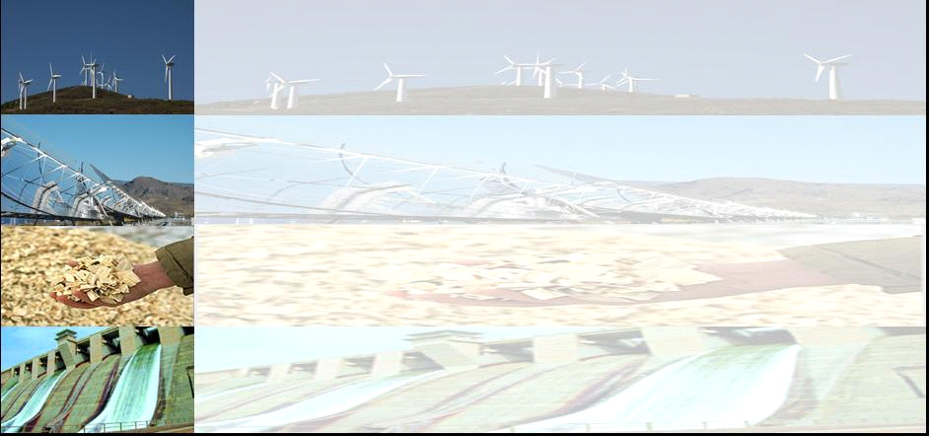
CZ-AT WINTER-SUMMER SCHOOL 2017
INTRODUCTION TO
“ENERGY SYSTEMS“
Reinhard Haas
Amela Ajanovic
Energy Economics Group (EEG)
at the Institute of Power Systems and Energy Economics
Vienna University of Technology
Tel. +43-1-58801-370303
Web: http://eeg.tuwien.ac.at

Slide 2
CONTENT:
  Motivation: Energy problems
  2. Basic principle: Providing energy services – not consumption of energy !
3. Energy chains and energy systems
  4. Dynamics: Why history is important
  5. Visions of future energy systems

Slide 3
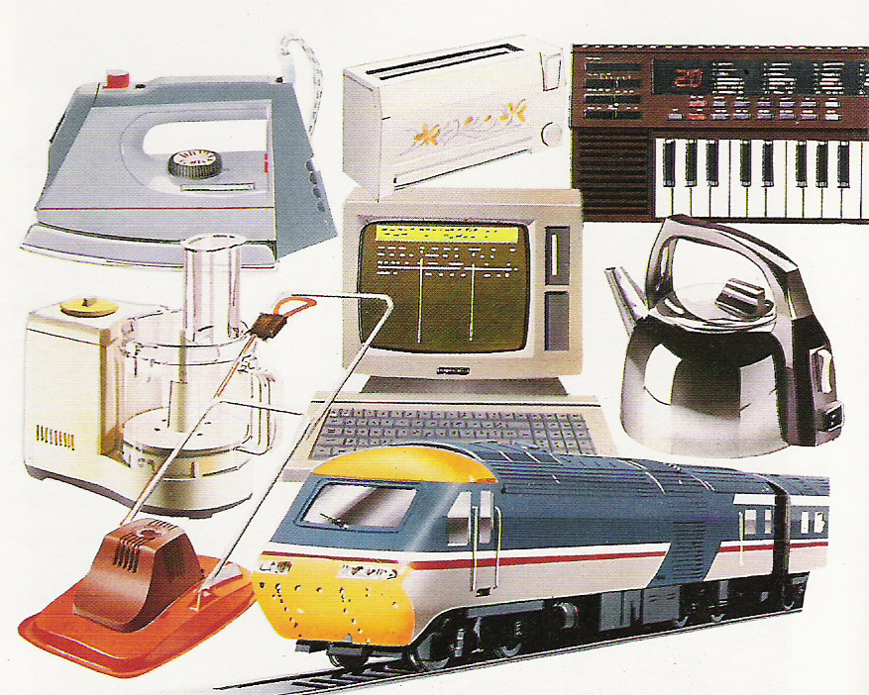
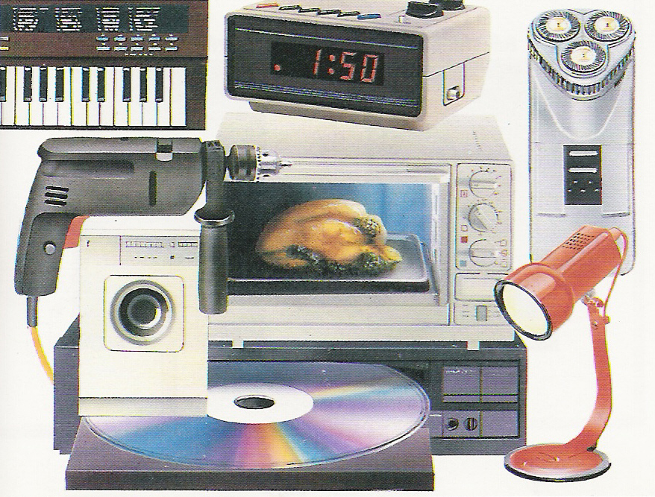
1. MOTIVATION:
Why are we here today?
Energy is the fundament of our standard of life today
Every second of our life – even in deep sleep –
we „consume“ energy
Dramatic increase in energy consumption in recent years!
Dramatic increase in electricity consumption
in the next decades expected!

Slide 4
LIMITED
RESOURCES:
Renewable,
Fossile,
nuclear,
ENVIRONM.
EXTERNALI-
TIES (CO₂, SO₂ radiation)
ENERGY
“PROBLEMS“
SOCIAL:
UNEVEN
CONSUMP-
TION
SUPPLY
SECURITY:
NATURAL
GAS, OIL

Slide 5
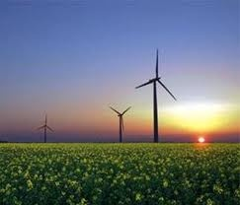

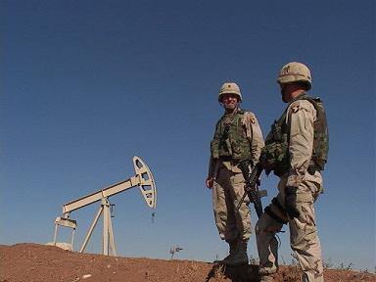

The Key Energy Challenges
Climate Change
Energy Security
Energy Access
Air Pollution
Health Impacts
Notes:
The Energy Program aims to identify viable policy mechanisms, leverages, and technology portfolios that would permit the transformation of the present energy system to a more sustainable one. The following list of key challenges in the transition toward a sustainable energy future are explicitly analyzed in the research of the Energy Program:
Providing universal access to affordable clean cooking and electricity for the poor
Improving energy security throughout the World
Limiting air pollution and health damages from energy use
Limiting climate change
5

Slide 6
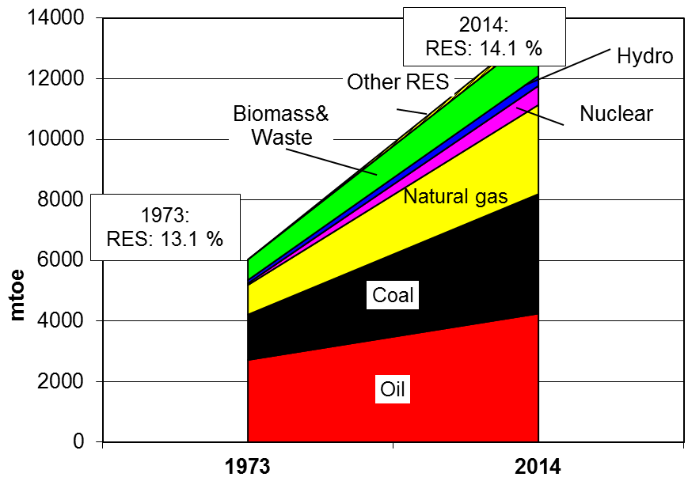
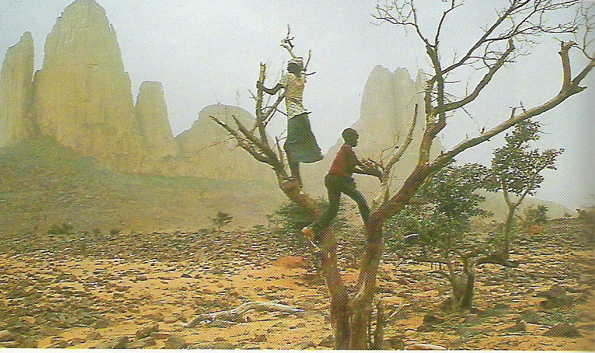
WORLD-WIDE TREND IN
PRIMARY ENERGY
20000
mtoe!
2030
Source: IEA (2016)

Slide 7
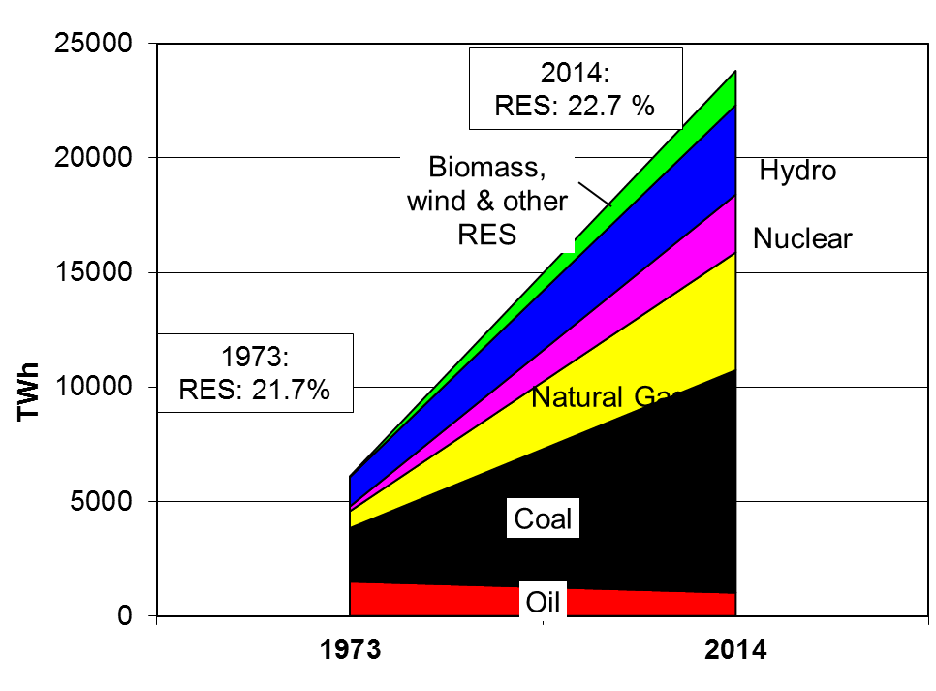
WORLD-WIDE TREND IN ELECTRICITY CONSUMPTION
32000
TWh !
Factor 4!
Source: IEA (2016)
2030

Slide 8
PRIMARY ENERGY: TRENDS
BY FUEL
7 000
7 000
6 000
6 000
Oil
5 000
5 000
Natural gas
4 000
4 000
Mtoe
Mtoe
3 000
3 000
Coal
2 000
2 000
Other renewables
1 000
Nuclear power
1 000
Hydro power
0
0
1970
1970
1980
1980
1990
1990
2000
2000
2010
2010
2020
2020
2030
2030
IEA: Fossil fuels will continue to dominate the global energy mix,
while oil remains the leading fuel!

Slide 9
Oil consumption over time
0
1000
2000
3000
4000
Zeit

Slide 10
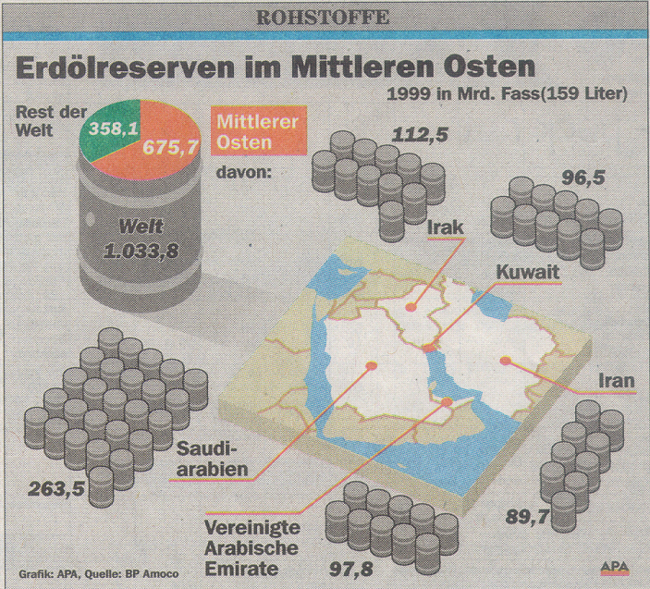
Oil reserves in the Middle East
Middle East: 2/3
Rest of world: 1/3

Slide 11
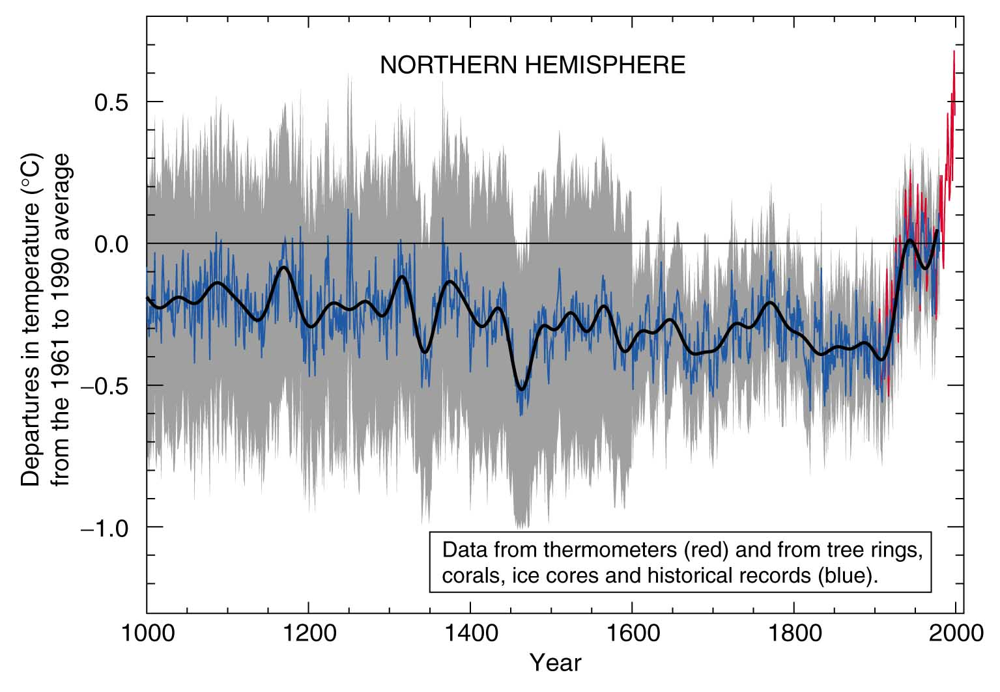


Variations of Earth’s Surface temperature in the past 1000 years
1.5°
INTERGOVERNMENTAL PANEL ON CLIMATE CHANGE (IPCC)
Source: IPCC, 2001a

Slide 12
Variations of Earth’s Surface temperature in the past 110 years
+ 2° !

Slide 13
Per Capita Final Energy & Population
Uneven consumption

Slide 14
Uneven consumption:
30/70 - 70/30
30% of World
population:
70% of World
population :
70% of
energy!
30% of
energy!

Slide 15
2. The basic concept of
providing energy services
There is no interest to consume energy.
There is a demand for energy services:
clean shirts, warm and bright rooms, cold
beer, hot coffee.
Inputs: Energy, Technology, human capital,
environment
Energy services are produced :
S = E η (T)

Slide 16
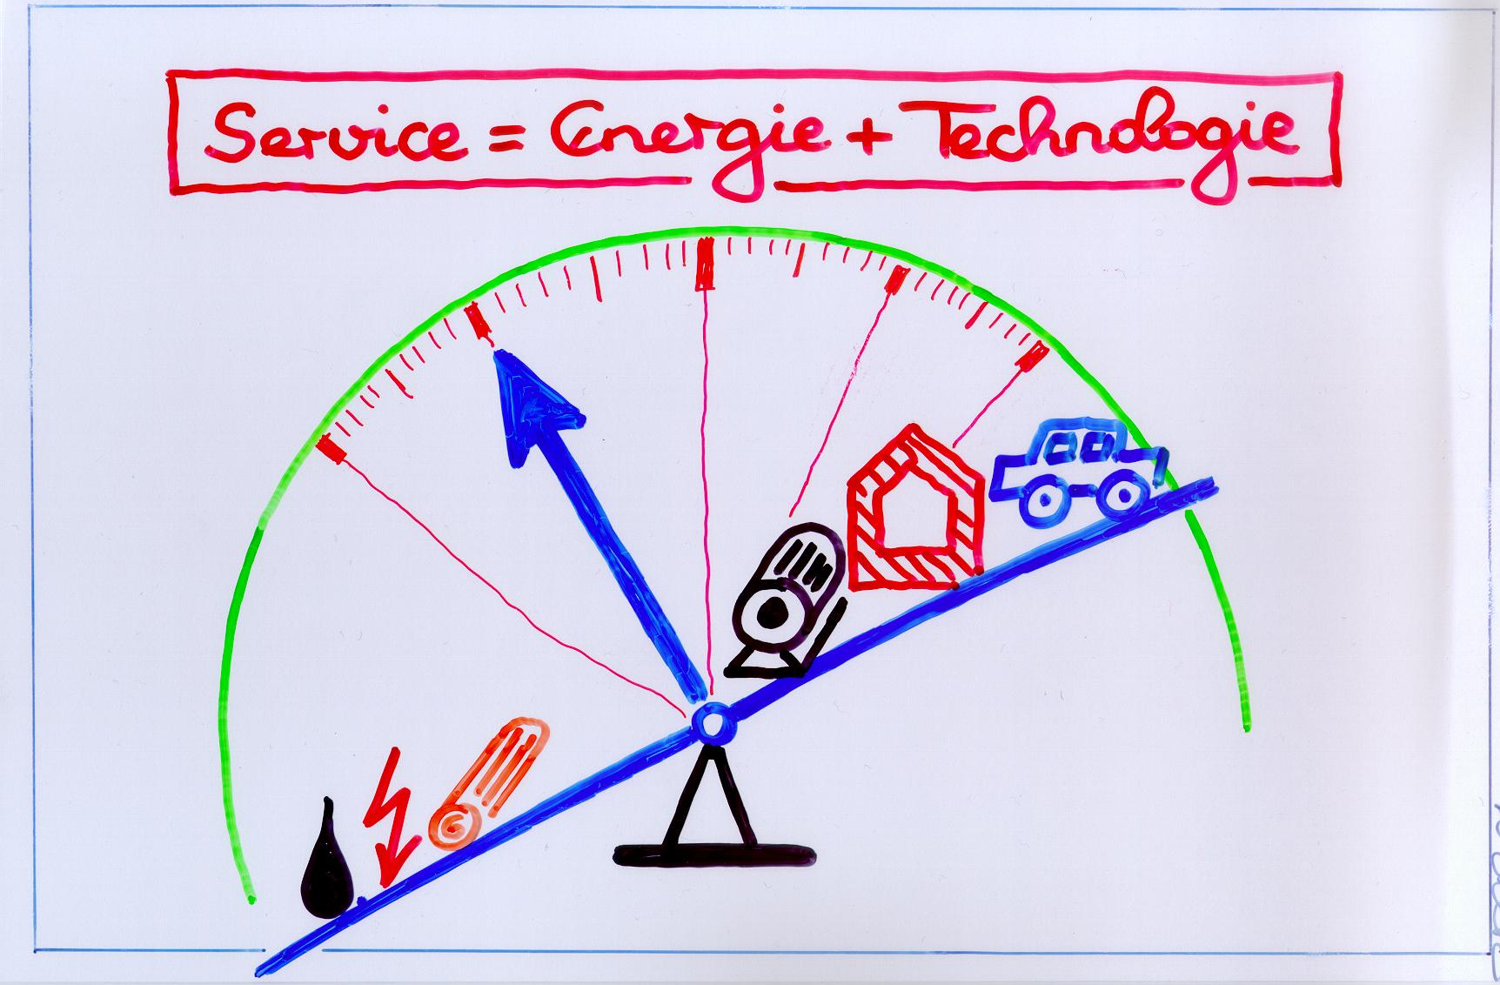
Service = Energy x Technology !
But currently the balance is biased tremendously:
To much energy, far to less technical efficiency!

Slide 17
What are energy services?
Direct energy services:
Lighting
Heating, cooking
Mobility, Transport
…
Indirect energy services:
Food
Shoes, Shirts
Communication
What you can buy in a super market!

Slide 18
Direct Energy services
(Non-)Commercial
ENERGY
ENERGY
Commercial
level
CONVERSION TECHNOLOGY (E.G. BOILER, SOLAR COLLECTOR, CAR...)
ENERGY
DIRECT
Energy services
e.g. Mobility, bright and warm/cool rooms
Source: Nakicenovic/Haas (2010)

Slide 19
Indirect Energy services
ENERGY
ENERGY
ENERGY
Source: Nakicenovic/Haas (2010)
ENERGY
PRODUCTION TECHNOLOGY
(MACHINE)
MATERIAL
INDIRECT
Energy Services
e.g. clothes, houses, shoes, pencils...)
Commercial
level

Slide 20
3. Energy chains and
energy systems
Categories of energy:
Crude oil, wood,
coal, natural gas,
solar, hydro, nuclear
Gasoline,
electricity,
pellets, district heat
Heat, light, mechanical work,
Warm and bright rooms, mobility ....
USEFUL
ENERGY
ENERGY
SERVICES
FINAL
ENERGY
PRIMARY
ENERGY
Losses final customer
Losses conversion
Losses exploration and transport
Source: Nakicenovic/Haas (2010)

Slide 21
What is an energy system?
An energy system comprises an energy supply and an end-use sector.
The supply sector consists of processes for extracting energy resources, converting these into more desirable and sustainable forms of energy and delivering these to places where the demand exists.
The end-use sector provides services such as cooking, illumination, transportation and consumer goods.
The purpose of the energy system is the fulfillment of demand for energy services.

Slide 22
What is an energy system?
Source: Nakicenovic et al (1997)

Slide 23
ARCHITECTURE OF THE
ENERGY SYSTEM: EXAMPLE!
Communicating with Grandmother
Source: Nakicenovic/Haas (2010)

Slide 24
Global Energy Flows
ENERGY
EXAMPLES
500 EJ
Primary
Conversion
Refinery
Power Plant
120 EJ
380 EJ
Secondary
Gasoline
Electricity
30 EJ
Distribution
Truck
Grid
150 EJ
350 EJ
Final
Gasoline
Electricity
160 EJ
End use
Car
Light Bulb
310 EJ
190 EJ
Useful
Kinetic
Radiant
190 EJ
3.3 Gtoe
Services
Pass-km
Light
500 EJ
Light
WASTE AND REJECTED
ENERGY

Slide 25
Units (“Currencies”)
and conversion factors
for measuring energy demand
Units for Orders of Magnitude
Symbol
Name
Magnitude
Number
Expression
P
Peta
1E+15
1 000 000 000 000 000
quadrillion
T
Tera
1E+12
1 000 000 000 000
trillion*
G
G
iga
1E+09
1 000 000 000
billion
M
Mega
1E+06
1 000 000
million
K
Kilo
1E+03
1 000
thousand
h
Hekto
1E+02
100
hundred
da
Deka
1E+01
10
ten
-
1E+00
1
one
d
Dezi
1E
-
01
0.1
tenth
c
Centi
1E
-
02
0.01
hundredth
m
Milli
1E
-
03
0.001
thousandth
µ
Mikro
1E
-
06
0.000 001
millionth
n
Nano
1E
-
09
0.000 000 001
billionth
p
Piko
1E
-
12
0.000 000 000 001
trillionth
* UK: milliard = 1E+12
Source: Nakicenovic/Haas (2005)

Slide 26
Some basic reflections:
1 Wh = 3600 Ws = 3600 J =3.6 kJ
1 kg oe = 11.63 kWh = (X 3.6 ) 41.87 MJ
(1 BTU = 1055 J)
1 Cal = 4.19 J

Slide 27
Useful conversion factors
on country level
1 TWh = 3.6 PJ = 0.086 Mtoe
1 PJ = 0.2778 TWh = 0.0239 Mtoe
1 Mtoe = 41.87 PJ = 11.63 TWh
(10¹² BTU = 1.055 PJ)
Example 1:
World energy consumption (PE):
12000 Mtoe = 500 000 PJ = 500 EJ (Exa-Joule)
Example 2:
World electricity consumption (PE):
000 TWh = 000 PJ

Slide 28
Examples:
Selected countries :
Austria: 32.4 Mtoe PE, Losses to FE: 21%, 65.8 TWh electricity
Czech Republic: 43.4 Mtoe PE, Losses to FE: 21%, 57.0 TWh electricity
In which country is share of
electricity on final energy highest?

Slide 29
Conversion factors for
energy
 |  | To : | PJ | Gcal | Mtoe | 10^12 BTU | TWh
 |  |  | multiply by
From : | PJ |  | 1 | 238800 | 0.0239 | 0.9479 | 0.2778
 | Gcal |  | 4.1868 x 10 ⁻⁶ | 1 | 10 ⁻⁷ | 3.968 x 10 ⁻⁶ | 1.163 x 10 ⁻⁶
 | Mtoe |  | 41.868 | 10 ⁷ | 1 | 39.68 | 11.63
 | 10^12 BTU |  | 1.055 | 252000 | 0.0252 | 1 | 0.2931
 | TWh |  | 3.6 | 860000 | 0.086 | 3.412 | 1

Slide 30
4. Dynamics:
Why history is important
The level of energy service
consumption:
technology was the driver!
based on
commercial energy
Electricity, combustion engine
Amount of energy services per capita
Sailing ship
Fire
Steam machine
based on non-commercial renewable energy
Source: Nakicenovic/Haas (2010)
time

Slide 31
From Antiquity to
the Steam Age
For the longest period in history:
Main sources of energy human and animal work, biomass (fire), mechanical wind and water.
Reasons for the humble improvements in energy use and technologies:
Work of many served only a few due to generally highly hierarchal social structures
General dislike of purpose-oriented technology
Low population densities and lack of population growth to accumulate knowledge!

Slide 32
Steam Engine
Papin (1690)
Newcomen (1712)
Watt (1769)

Slide 33

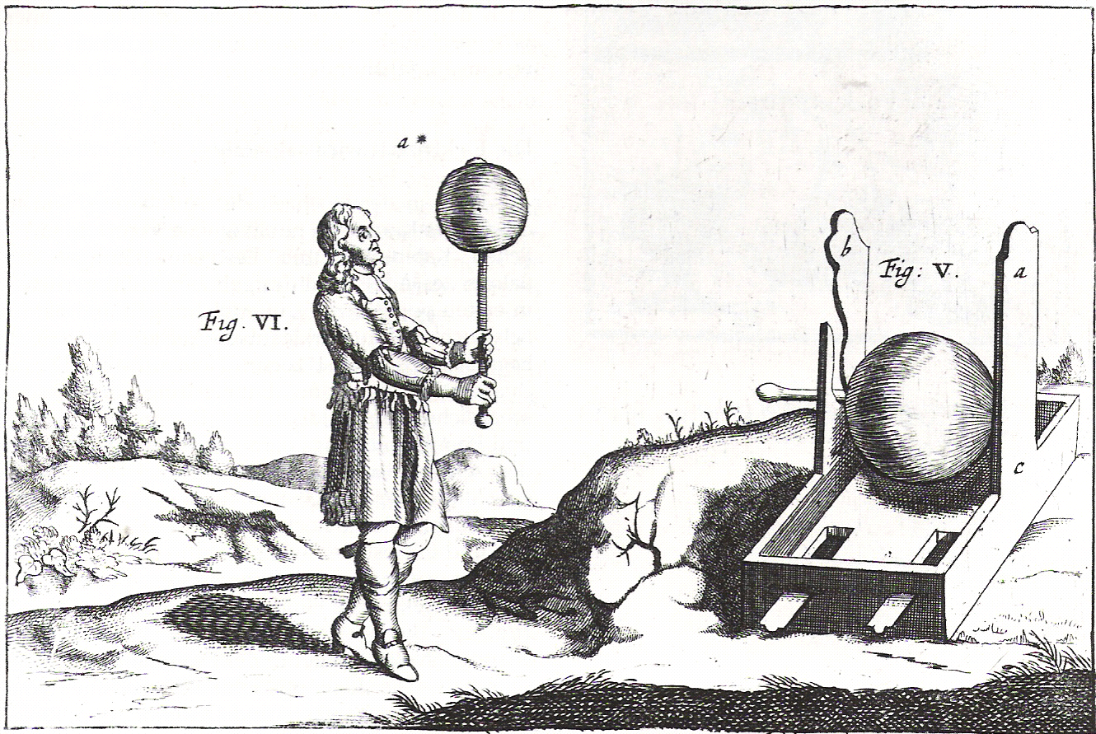
Electricity – THE energy carrier
Otto v. Guericke
Electricity – THE universal technology for providing energy services

Slide 34
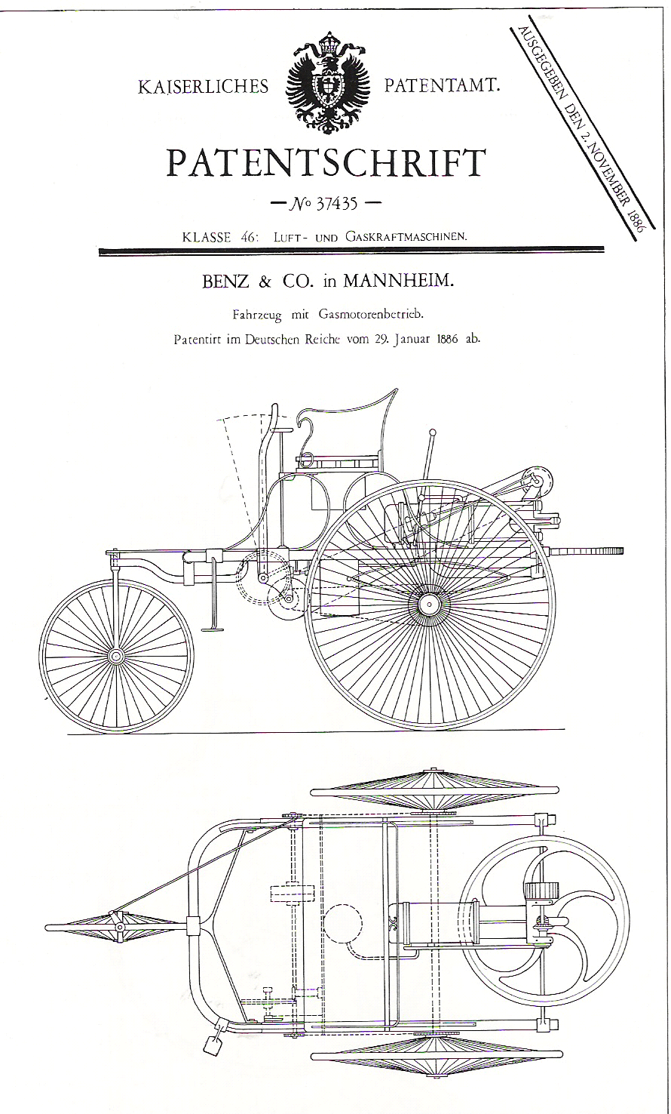
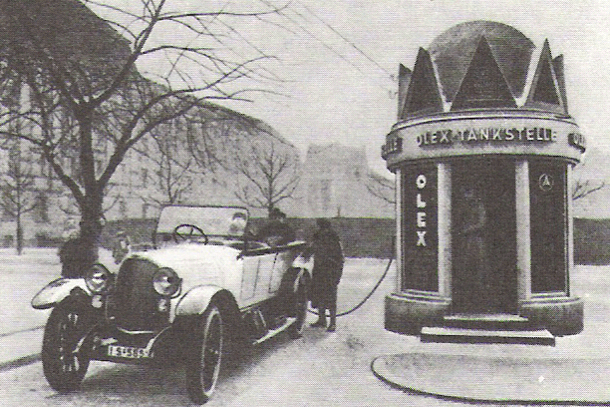
A new era of mobility: oil and combustion engine
Oil products in vehicles end of
19th century, begin of 20th century

Slide 35
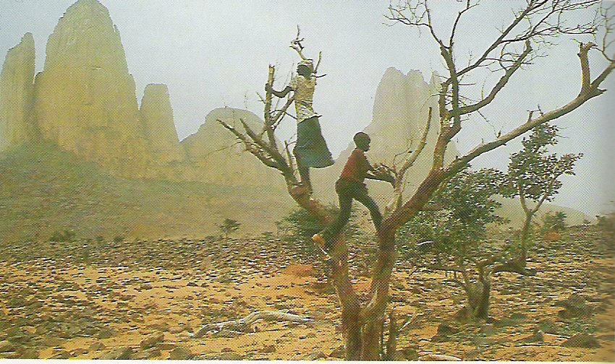
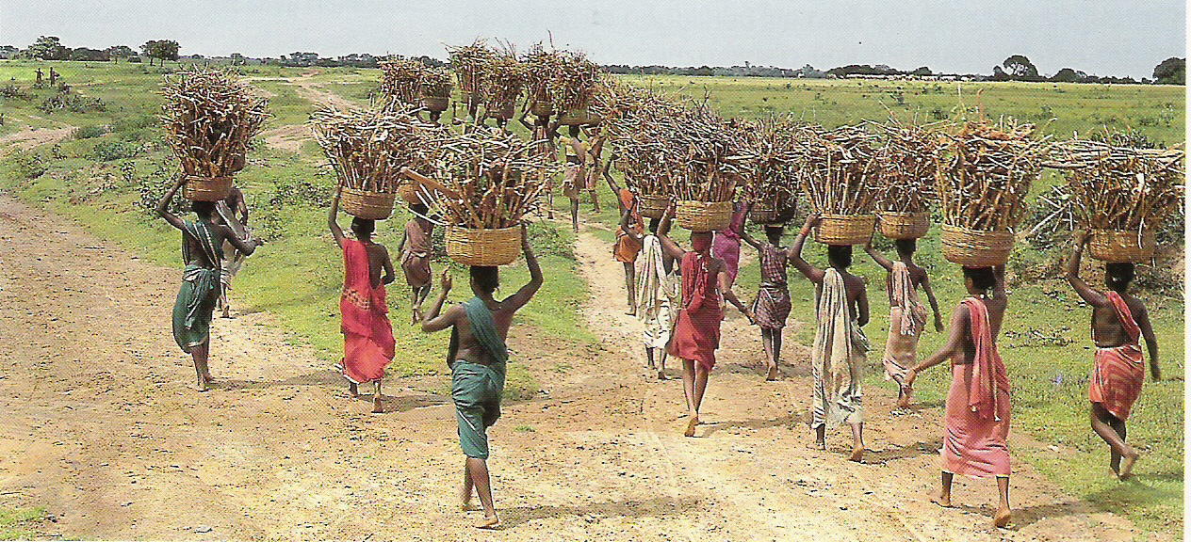
Energy crises
Wood crises:
7000 – 0 BT: Deforestation
along coasts;
1500 – 1700: England, Germany
Today: Africa, India…
major reasons:
non-sustainable use;
distance to place of use, transport, lack of infrastructure,
inefficient use;
Coal crises:
1870…
Oil crises:
1973, 1979,
2005 (?) …
Source: Nakicenovic/Haas (2010)

Slide 37
World: Primary energy
1973
2014
Source: IEA 2016
6115 Mtoe
13371 Mtoe
Total primary energy demand more than
doubled between 1973 and 2014;
Oil down (more than -30%!), Gas up, Coal up!

Slide 38
World: Final energy
1973
2014
4674 Mtoe
9425 Mtoe
The share of electricity increases continuously:
In 2014 twice of 1973
Share of oil decreased from 48% to 39%
** Other includes Solar, Geothermal, Wind
Source: IEA 2016

Slide 39
References:
EU/DGTREN/EUROSTAT (2014): Energy database
EU: http://www.europa.eu.int (2014)
Fouquet/Pearson: Seven centuries of energy service: Lighting
The Energy Journal (2006)
Fouquet/Pearson: Long run trends in energy service: Transport
(2003)
GEA: Global Energy assessment (2012)
Haas et al: Towards Sustainable energy systems, Energy Policy,
(2008)
Nakicenovic/Haas: Scripts Energy Economics, 2012
IEA: World Energy Outlook (Paris, 2013)
IEA: Key world energy indicators 2014 (Paris, 2014)

Slide 40
FOR FURTHER INFORMATION:
    Homepage:
    www. eeg . tuwien . ac . at
    E-Mail :
    Reinhard.Haas @ tuwien . ac . at

Slide 41
A small Seminar work on:
Czech Republic, Austria, EU-28, USA, China:
What are major primary sources?
What are major sources for electricity generation?
How did greenhouse gas emissions develop over the last decades ?
How did energy and electricity consumption develop over the last decades?
Is the country net importer of energy (oil, gas) and electricity?

